Slide 1
文献汇报
胡敬玉
2019.7.20

Slide 2
文献
Y. Kwon, J.-H. Won, B. J. Kim, and M. C. Paik, “Uncertainty quantiﬁcation using Bayesian neural networks in classiﬁcation: Application to ischemic stroke lesion segmentation,” in Proc. MIDL 2018.
MIDL: Midical Imaging with Deep Learning
Department of Statistics
Seoul National University
首尔大学

Slide 3
问题阐述
深度学习在计算视觉的多种任务上取得了非常好的效果
可解释性差
缺少不确定建模
提出了一种不确定性建模的方法

Slide 4
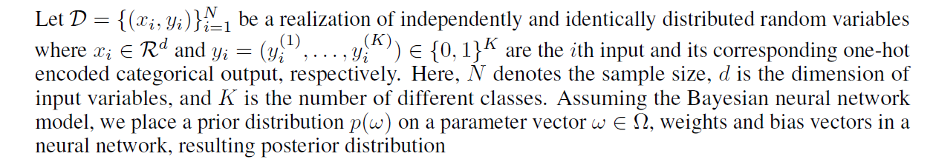
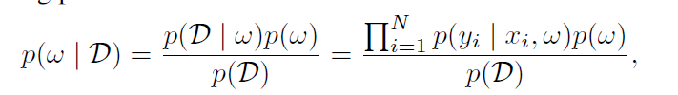
Bayesain Neural Networks

Slide 5
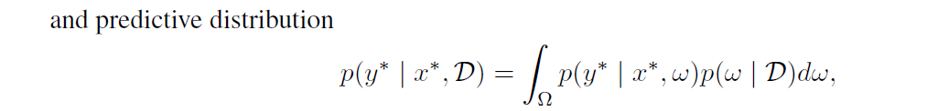
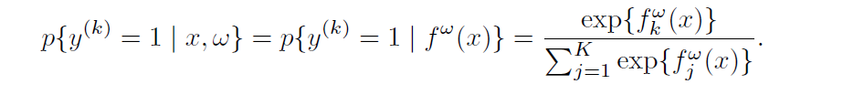
直接求
是比较困难的(intractable)
近似的方法
Hamiltonian Monte Carlo
Variational Inference

Slide 6
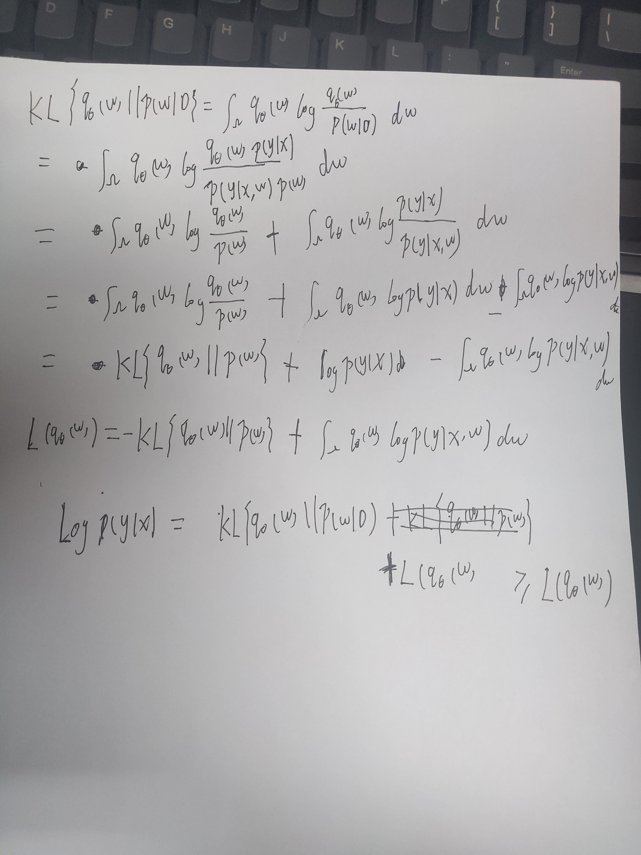
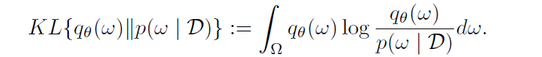
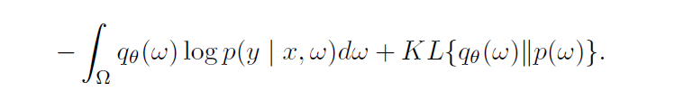

Slide 7
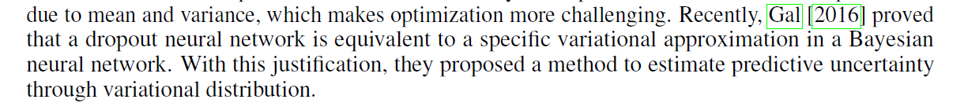
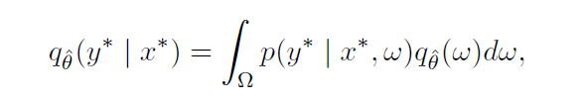
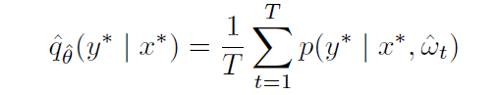
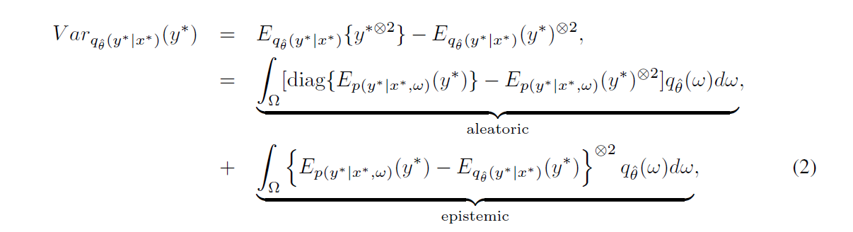
Gal Y, Ghahramani Z. Dropout as a bayesian approximation: Representing model uncertainty in deep learning[C]//international conference on machine learning. 2016: 1050-1059.

Slide 8
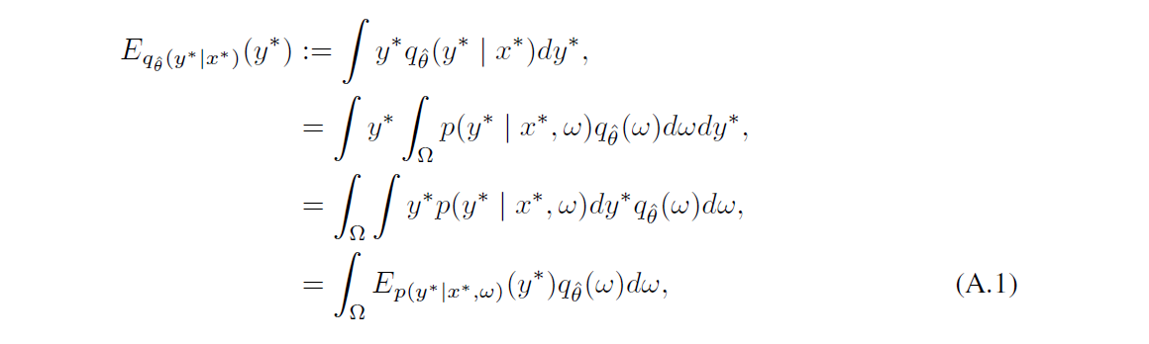
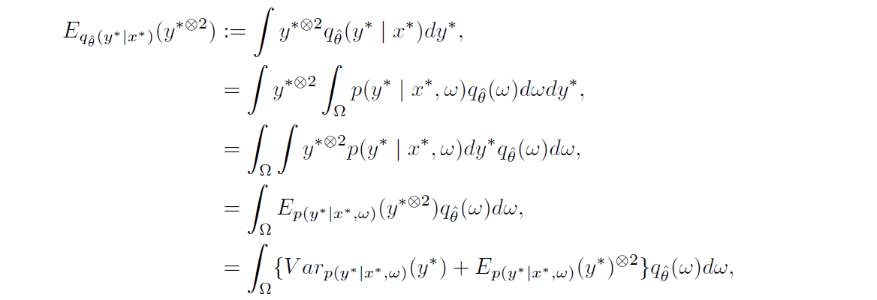

Slide 9
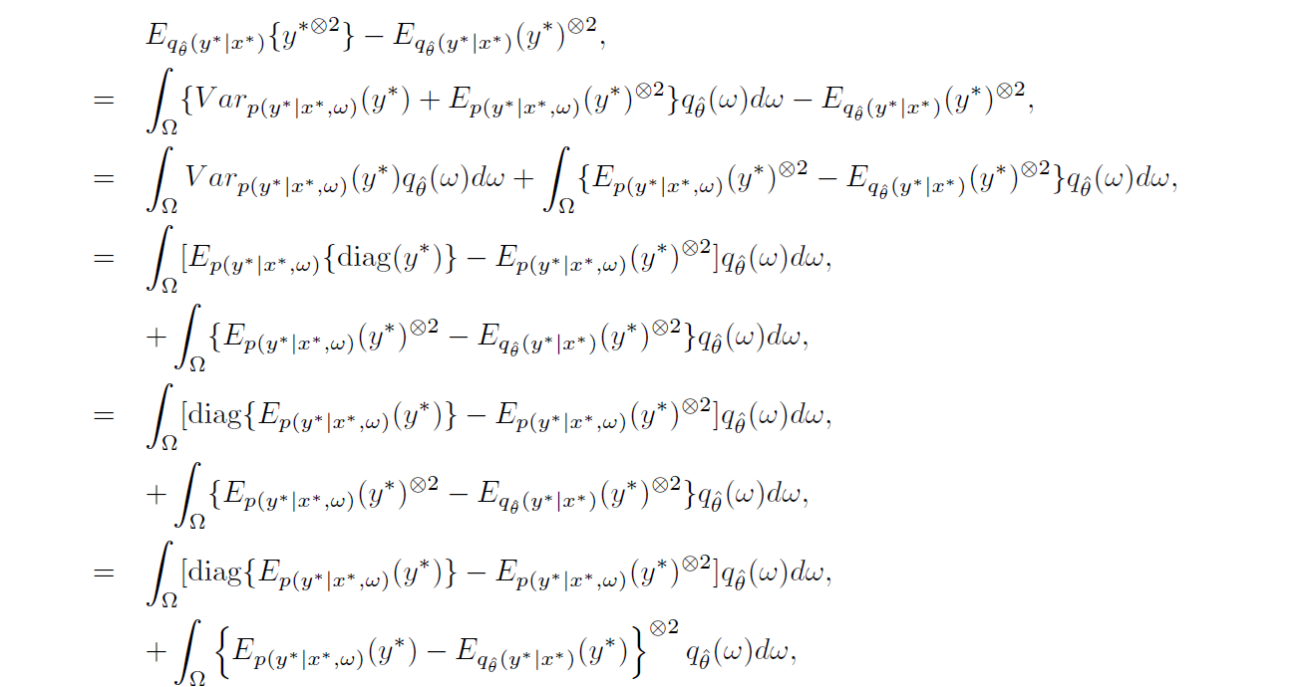

Slide 10
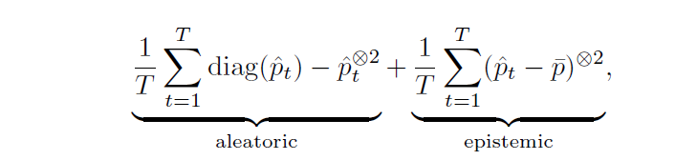
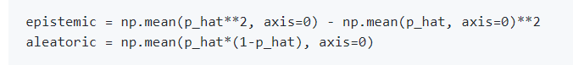
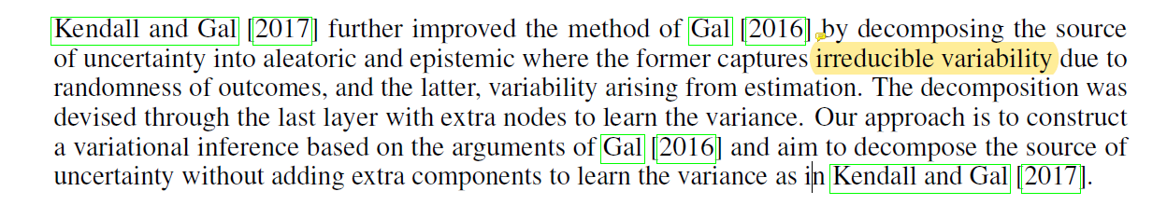

Slide 11
模型

Slide 12
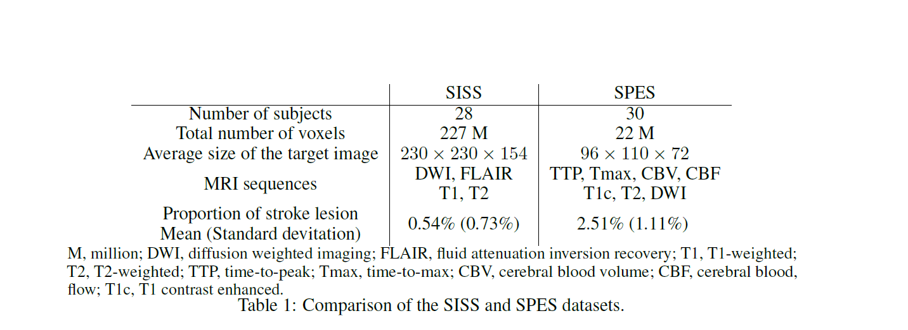
Ischemic Stroke Lesion Segmentation
缺血性中风

Slide 14
Thank You!

